Slide 1

Fueldup Consumer Behavior
Team Dynamic TRiO:
Sahil Agarwal
Tanay Patel
Aakash Patel
Notes:
Team:

Slide 2

What is Fueldup?

Slide 3
Company Background
Startup company with innovative idea of delivering gas to people.
Small convenience fee of $1.99 for office delivery or $2.99 for home delivery.
Serves areas weekly or bi-weekly.
Change prices daily based on OPIS (Oil Price Information Service) rates so they can deliver gasoline at or below local gas station price.

Slide 4




How it works
Schedule
Notify
Park
Drive
Set up your profile with service location and scheduling preferences.
Receive notification on the day of service
Park in your normal location and pop your gas flap.
Return to your vehicle fueldup

Slide 5
Business Problem
The idea of delivering gas to people’s car is very new in the Oklahoma market
Stepping foot in this new market recently, Fueldup doesn’t have their target customers
Our analysis will pinpoint group and areas Fueldup should target in Oklahoma to generate most revenue

Slide 6
Research Questions
Which county has the largest number of registered vehicles and the amount of gas taxes collected?
Which county has individuals whose income is more than the average income of an individual in Oklahoma?
Which county has the highest average commute time of people commuting for work?

Slide 7
Dataset
Data was collected from several different sources:
Demographic dataset
Vehicle registration dataset
Gas excise tax dataset
Zip code dataset
FIPS (Federal Information Processing Standard) zip code dataset

Slide 8
Data Understanding
Demographic dataset
Provides information about the demographics of Oklahoma’s residents for year 2015 and 2017.
Vehicle registration dataset
Provides information about vehicle registered in each county.
Gas Excise Tax dataset
Provides information about the gas excise tax paid by the cities in Oklahoma.
Zip code dataset
Provides city, county and state information based on zip code.
FIPS (Federal Information Processing Standard) zip code dataset
Provides county and state information based on zip code along with unique FIPS code to identify counties.

Slide 9
Data Preparation
Cleaned every dataset before merging
Removed columns and rows whose 60% or more values were null, N/A, or NaN
Replaced some null values with 0.0 to assist in analysis process
Retrieved only Oklahoma state data and dropped others
Trimmed values in columns to get meaningful results
Created derived attributes
Exported final cleaned and merged dataset to .csv file

Slide 10
Methodology, Analysis and Findings

Slide 11
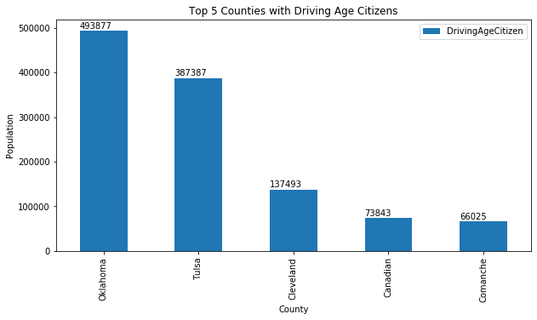
Driving Age Citizens

Slide 12
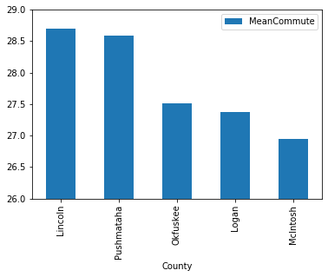
Average Commute Time

Slide 13
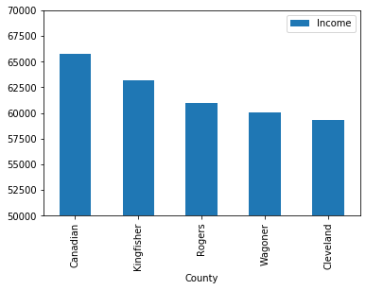
Average Income

Slide 14
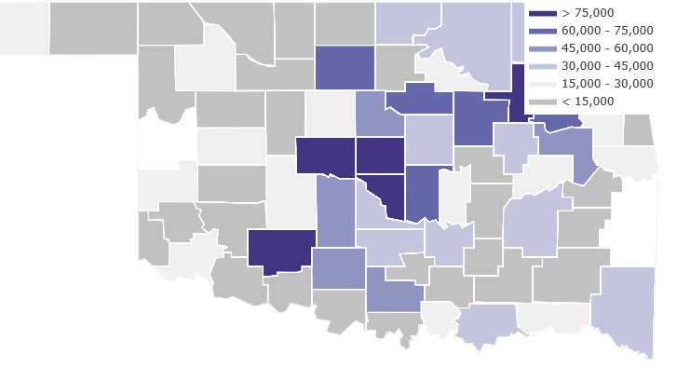
Registered Vehicles

Slide 15
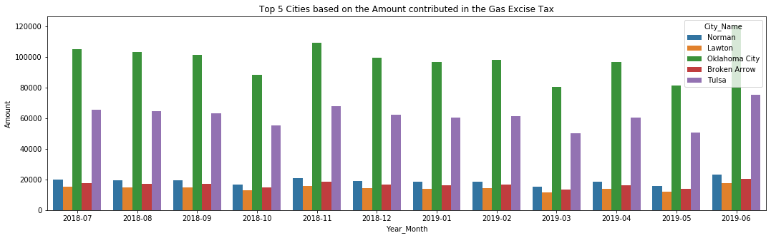

Slide 16
Statistical Analysis
Chosen important variables.
Gas tax amount
Number of vehicle registered
Total Population
Income
Drive (%)
Professional (%)
Linear regression
Predicting income based on total population.
Estimating professional based on driving percentage.

Slide 17
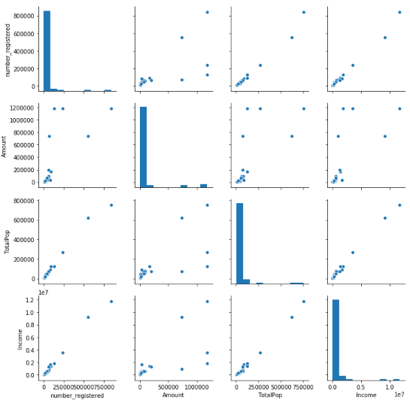
Statistical Analysis Cont’d
Unique point in each plot
Separated important counties
based on the points.
Chosen five common counties
from 12 scatter plots
Oklahoma, Cleveland,
Comanche, Tulsa, &
Canadian.

Slide 18
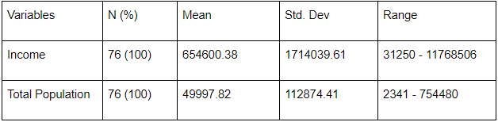
Linear Regression
Summary Statistics:
Model:
Estimated income = - 100959.74 + 15.11 * Total population
Fit of the model:
Adjusted R-square - 0.990
Interpretation:
Each person contributing $15 in their state income.
Minimum 6600 population required to get positive income.

Slide 19
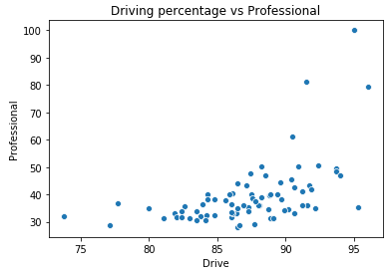
Scatterplot - Drive vs Professionals
More the driving percentage, more professional can be found in those counties.
Some unique points can be recognized from the plot.
From the graph, approximately 90% of the driver having more professionals as compare to others.

Slide 20
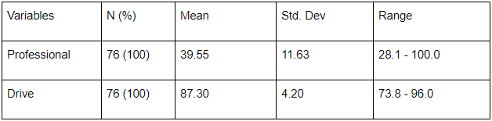
Linear Regression
Summary Statistics:
Model:
Estimated Professional = -90.55 + 1.49 * Drive
Fit of the model:
Adjusted R-square - 0.289
Interpretation:
For one percent professionals, state needs to have approximately 60% drivers.

Slide 21
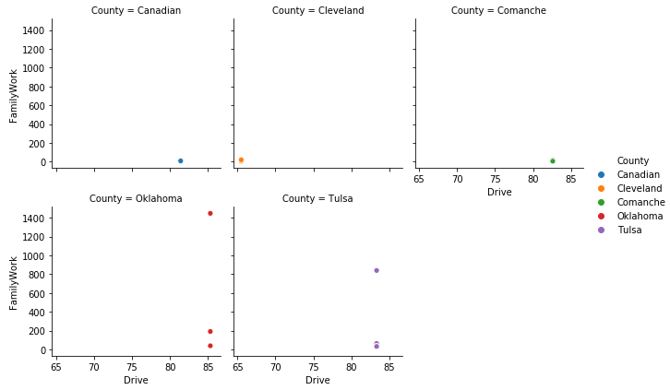
Relational plot of top 5 counties with Family Work & Drive
Observed:
Almost every county has
more than 80 driving percentage.
Few counties shows more family work as compare to others.
Oklahoma and Tulsa shows higher chances in terms of gas delivery.

Slide 22
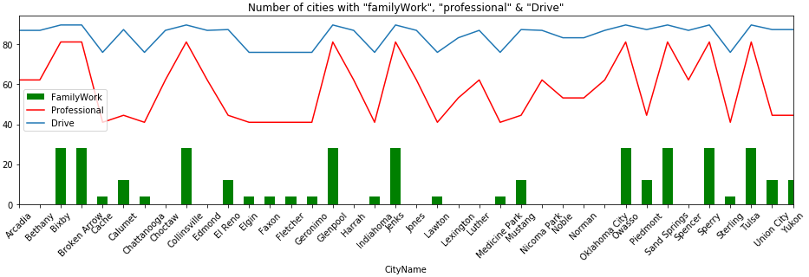
Cities based on percentage of drive, professionals & family work
Some cities has zero percentage of family work.
Notice: No family work has low professionals.
Driving percentage is almost constant in cities.

Slide 23
Conclusion & Recommendations
The analysis conducted on numerous Oklahoma datasets allowed us to gain some insight into Oklahoma counties, such as, where most vehicles are running, where high income society is, where most gas excise tax is generated, etc.
Recommendations:
Target customers in counties with high driving age population: Oklahoma, Tulsa, Cleveland, Canadian, and Comanche.
Advertise their service in high average commute time counties: Lincoln, Pushmataha, Okfuskee, Logan, and McIntosh.
Target areas that are resident to high income individuals (income > avg OK income: Canadian, Kingfisher, Rogers, Wagoner, and Cleveland.

Slide 24

Questions?

Slide 25
Thank You

